Slide 1

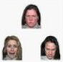
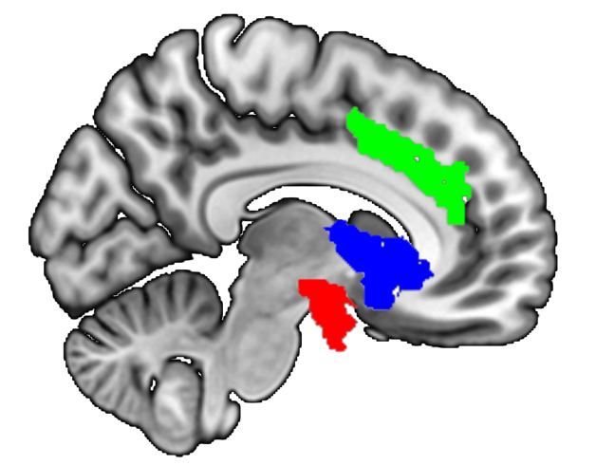
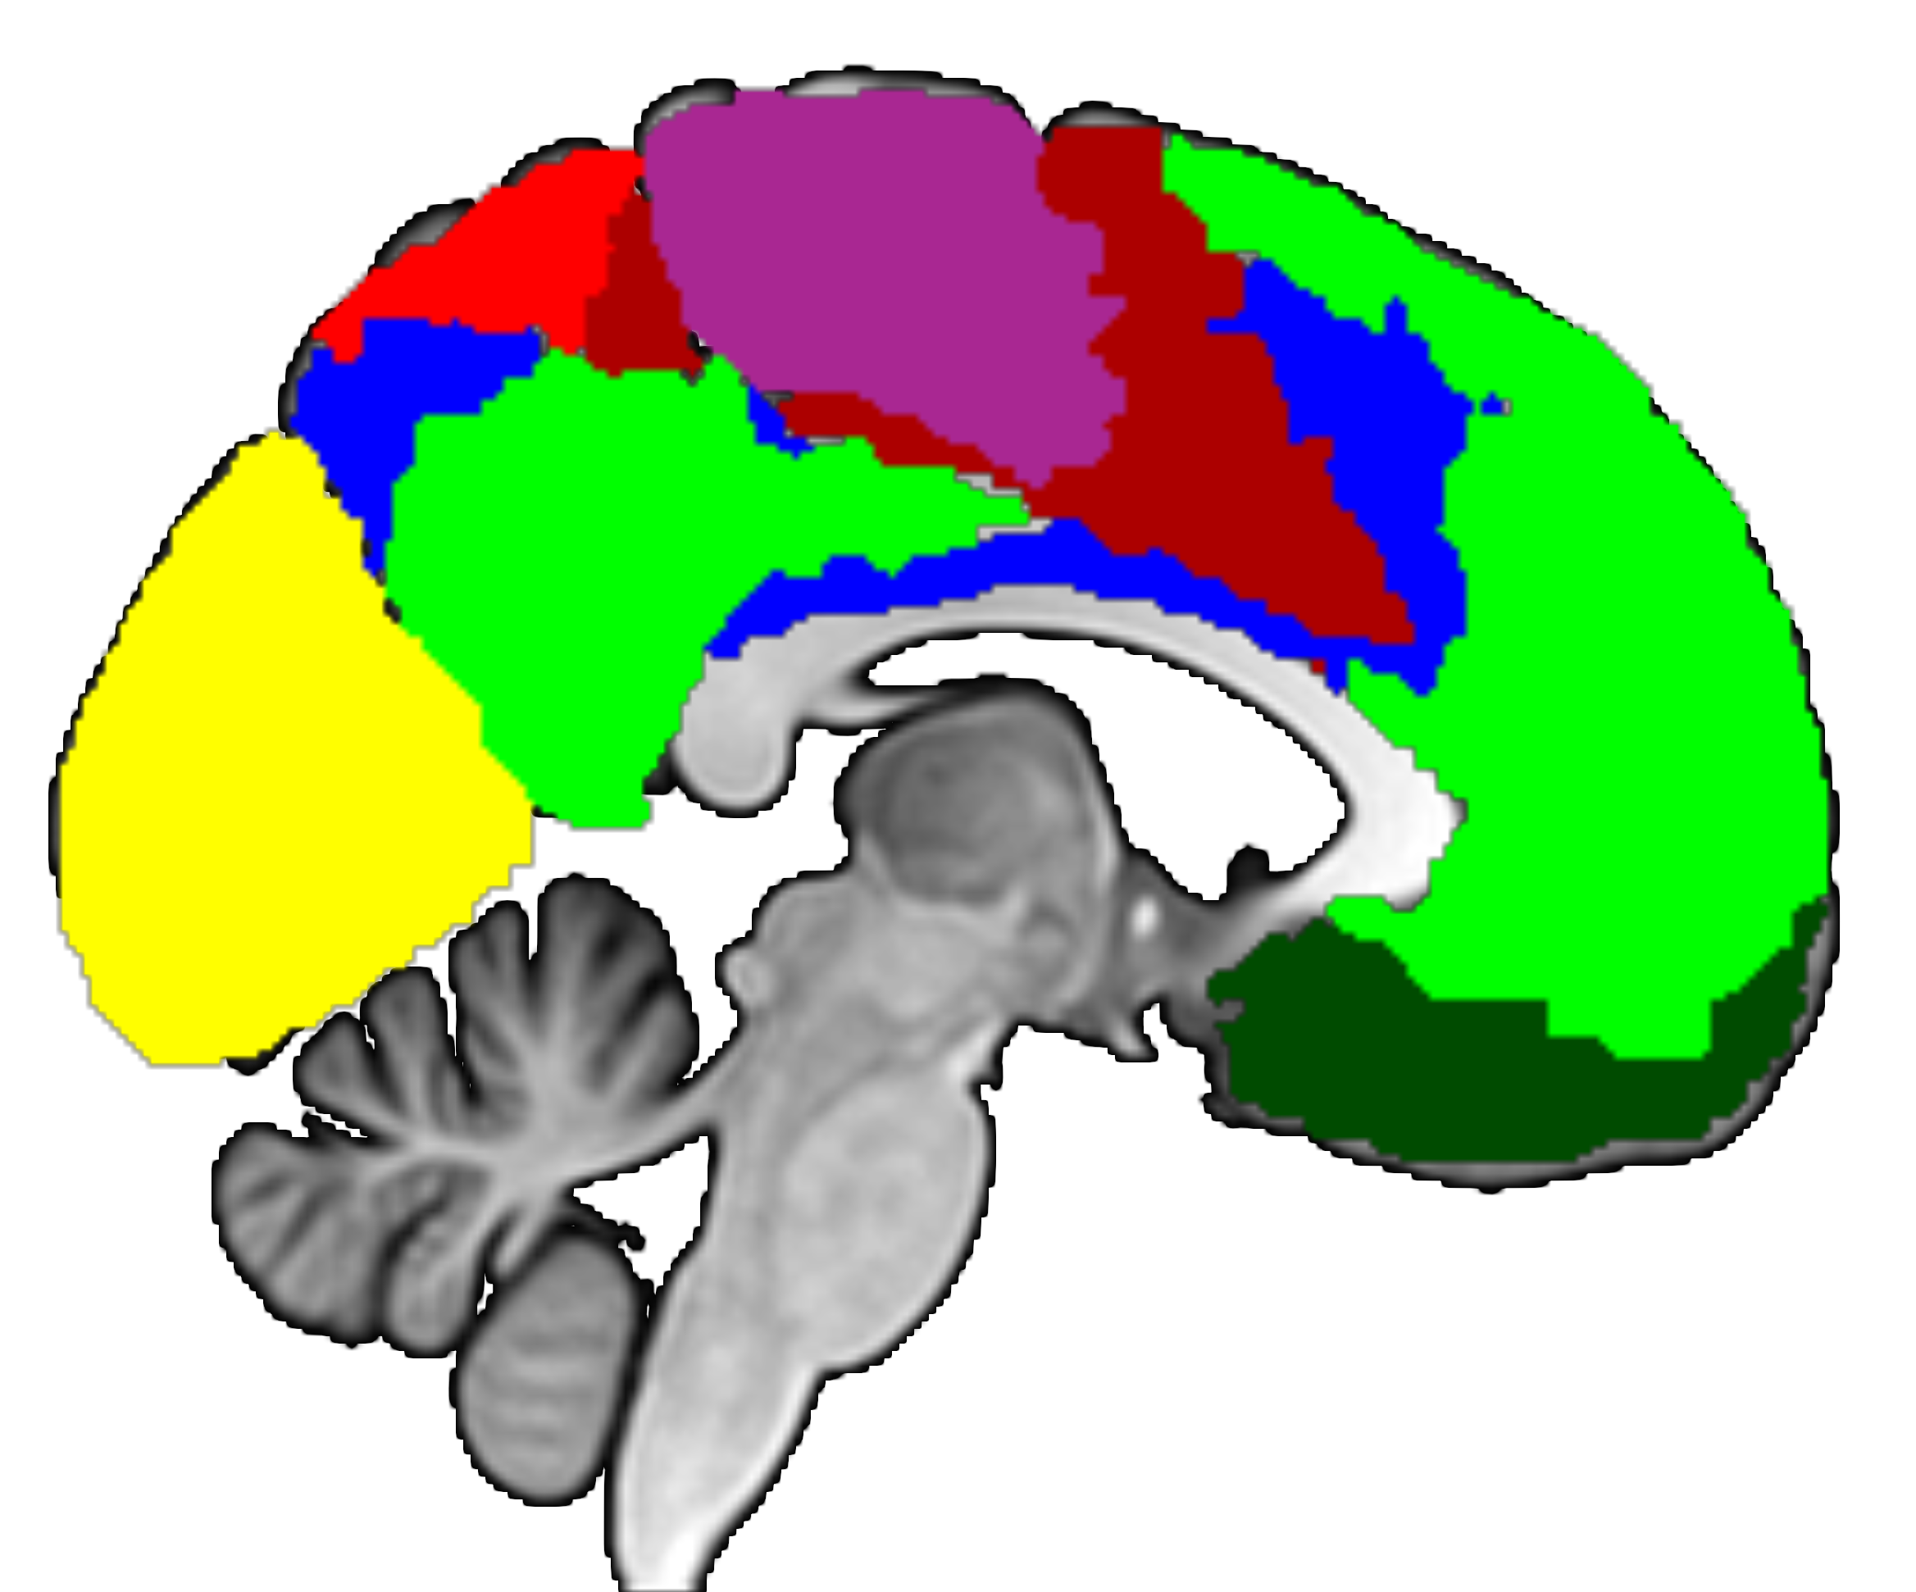
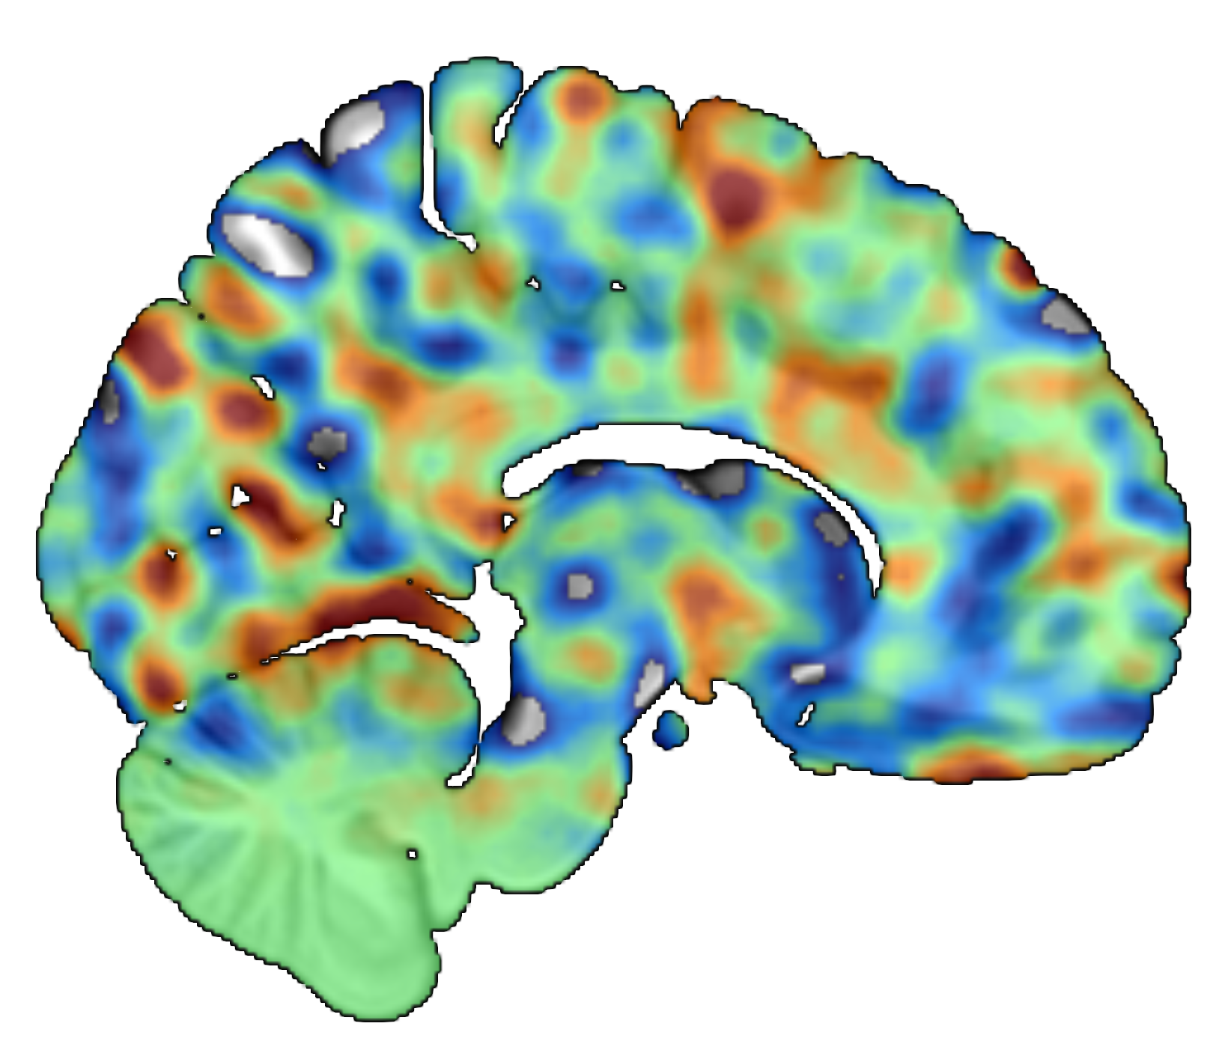
a) Tasks
Faces
Scenes
Look
2s
+
+
+
7s
4s
1
2
3
4
5
+
+
ITI
4s
Time
Time
1-3s
Blocks
b) Theory-driven analyses
Regions
Networks
Signatures
ROI
Average
ROI Machine
Learning
Best of 489 regions
Univariate
Multivariate (linear)
Multivariate (non-linear)
PINES
VIFS
Fear
Anger
Sadness
c) Whole-brain machine learning
 | Outcome | Algorithm | Task | Baseline | Scaling | Data
Stage 1 (12 models) | Neuroticism | PLS | Scenes Faces | Neutral Condition Implicit Baseline | No scaling Centering Z-Scoring | Training data
Stage 2 (252 models) | Six Sub-Facets Other-Reports Self-Other-Reports | PCR SVR
Stage 3 (1176 models; post-hoc) | Negative Affect Positive Affect Trait Anxiety Depressivity Task Affect | PCA-RF |  |  |  | Training + hold-out data
Added choices

Slide 2
